Slide 1
CHOICE HIGH SCHOOL PARENT ORIENTATION
Welcome to Choice High School. We are honored that you are interested in enrolling your student. You could have selected another school to provide an education for your children. We are humbled by your decision to inquire about our campus.

Slide 2
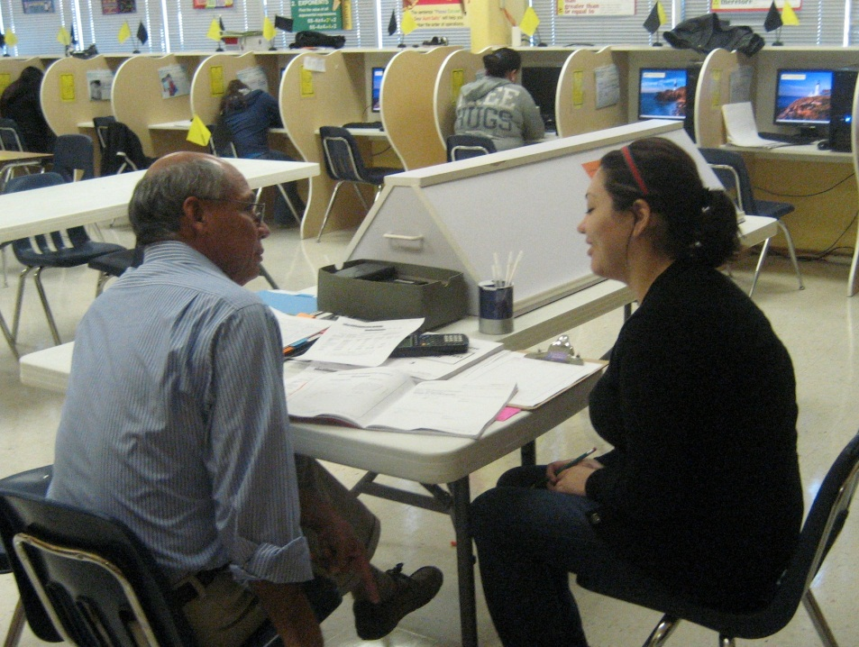
During the next few minutes, you will learn whether Choice High School is a good fit for your family. We believe it is, because Choice High School is a school of choice. Our campus is not like traditional schools with classrooms. Neither is Choice High School a punitive institution. It is designed as a safe place where students can focus on graduation without concern about safety issues or trying to keep up with or wait for teachers.

Slide 3
This presentation is designed to illustrate the strengths and differences of the Choice High School individualized learning system, and how your involvement in the educational process of your student is a vital part of our campus program.

Slide 4
The first step for you is to watch this presentation and make notes on items of interest or concern. If you are interested in pursuing enrollment of your student, you should request and complete an Intent To Enroll form. This form is your official notice that you are interested in enrolling your teenager in Choice High School.

Slide 5
One of the obvious differences between Choice and other high schools is the absence of regular classrooms in which students sit at desks and listen while teachers talk to and with students, and students complete assignments on a lock-step schedule. At Choice High School, learning is reading-based. Students sit in personal cubicles in a learning center, where students have privacy to focus on academic assignments.

Slide 6
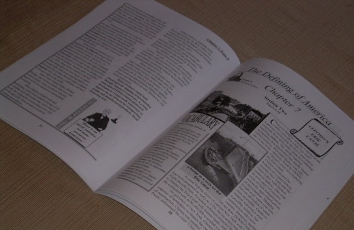
Most of the curriculum is available in individualized study texts. These academic materials are specifically designed to allow students to complete courses in a private atmosphere as rapidly as desired or as slowly as needed to earn transcript credit toward a diploma. Students sometimes participate in what is called blended learning…the combination of computer-delivered courses, tutorials, paper-based books, and/or classrooms participation.

Slide 7
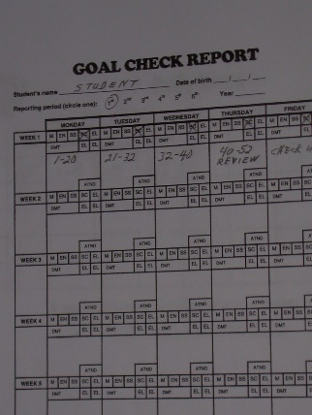
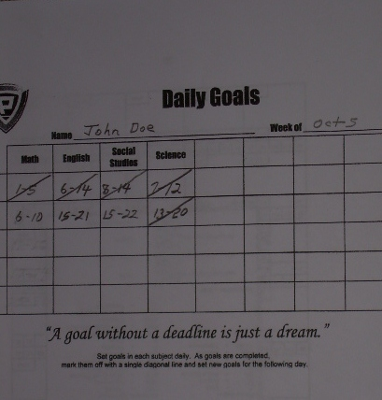
Earning transcript credits is not based on the calendar or the number of days students attend Choice High School. Students earn transcript credit only by completing all course work prescribed in the individualized curriculum. Some students complete courses in only a few months; others take longer. The difference is personal initiative, effort, and focus. In reality, students determine when courses are completed.

Slide 8
Choice operates on the principle that students who previously failed courses (in other schools) need to repeat only the failed portion of the courses. Moreover, students who are eager to graduate may accelerate their schedule and graduate “early.” Some students complete more than two years of academic work in one year! That could be your teenager. However, students are more likely to experience success in school when parents help, support, and assist school staff.

Slide 9
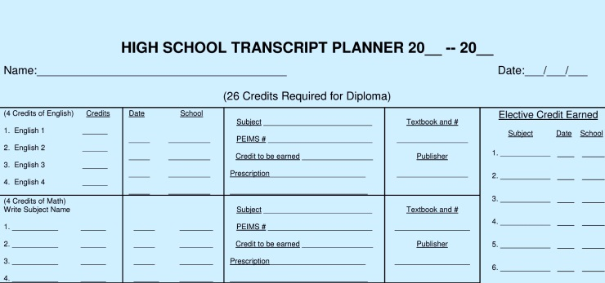
The enrollment process is designed to help your family learn about the individualized learning method, philosophy, and policies, and to enable our staff to work with you to determine the best schedule and academic program for your family.

Slide 10
You will be asked to participate in two or more interviews designed to help you and your child understand our program, and to allow you to provide insight that will help us design the best arrangement and academic package for your family.

Slide 11
You will then be issued an Application for Enrollment, which you must complete before you schedule an official enrollment interview with the campus administrator or his/her designated person. At the enrollment interview, you will discuss various topics, such as why you are seeking enrollment, reasons you withdrew from the previous campus, extenuating circumstances in your family, and other topics which may arise during the interview process.

Slide 12
You will be asked to read the Student Handbook and Code of Conduct, and sign a document that verifies that you have read and understand the policies which govern your student’s behavior while enrolled. The Student Handbook is the official campus policy established by the Board of Trustees regarding such items as daily attendance, attire, calendar, campus security, visitors, graduation requirements, special needs, consequences for non-compliance with campus rules, and how to make an appeal for remedy if you believe that your student has been treated in an unfair manner.

Slide 13
Choice High School is not an “alternative disciplinary campus.” It is a school of choice where campus personnel are obligated by state statute to uphold and apply Board policies in an equitable manner for all students. This practice gives every student equal access to opportunities available on campus.

Slide 14
You are welcome to discuss or comment on specific items in the Student Handbook and the school attendance calendar during the interview process. Please understand that staff are not permitted to “bend or break” campus rules when students violate policies pertaining to attire, attendance, or academics.

Slide 15
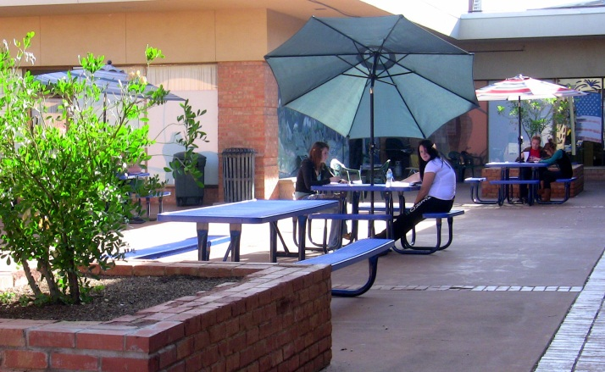
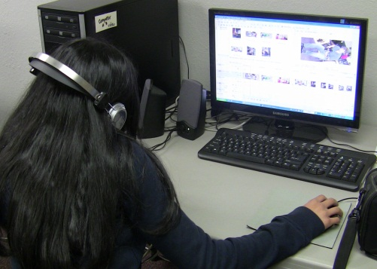
You will receive a short tour of the campus so that you may gain a mental picture of the facility: learning center, offices, and other areas where students may be in attendance to complete academic requirements.

Slide 16
Part of the interview process requires staff to obtain certain information regarding such items as free and assisted lunches, special needs, places and hours of parents’ employment, emergency contact names and phone numbers, language spoken in the home, and persons authorized to visit or pick up your children. Your help is needed to make sure our records are accurate and complete.

Slide 17
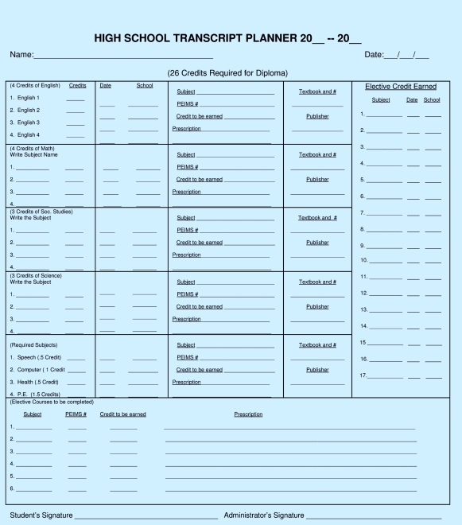
Throughout the year, you will be asked to participate in numerous conferences involving you, your child, and school staff in order to design the most effective school package for your family. Your help will be needed to select the specific courses your student will be required to complete for his/her diploma. An individual education plan (IEP) will be designed on a Transcript Planner with your assistance so that you and your student fully understand expectations and requirements for your family in order to earn a diploma.

Slide 18
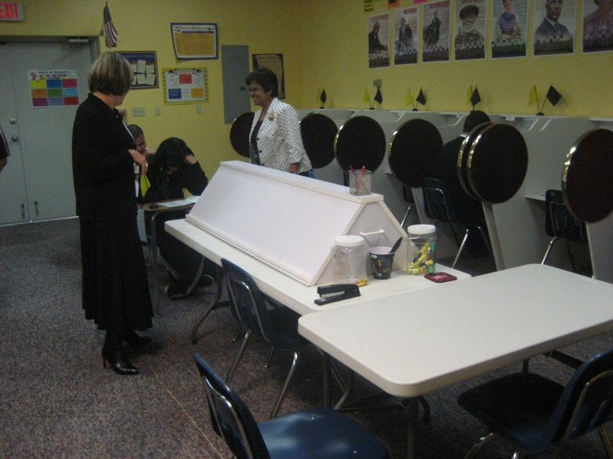
You will notice that parents are required to participate in parent-staff conferences as needed and usually every six weeks to make sure that you know how your child is progressing in his/her studies. You are always welcome to visit the campus to observe or inquire about your child.

Slide 19
At times, you may be invited to observe your child while he/she works on school assignments or receives special recognition for achievement. You may receive courtesy calls from staff periodically to inform you about positive acts regarding your child. Our mission is to keep you informed of both the positive and negative aspects of your child’s participation in Choice High School.

Slide 20
Regular written reports to you will be in the form of a Report Card, which is issued every six weeks. You are asked to review the card carefully, and to communicate with school staff regarding your concerns. As needed, you will receive a three-week Failing Report if your child does not satisfactorily complete required course work as planned on the Transcript Planner.

Slide 21
You will notice that the Report Card is not a true indication of your child’s academic progress. The real measure, or indication, of academic achievement, is the Progress Chart (sometimes called the Star Chart). A star is placed on the Progress Chart in the appropriate week of school very time your child passes a quiz or test during each six-week reporting period. A glance at the student’s Progress Chart will reveal whether your child is lagging behind or accelerating his/her academic schedule.

Slide 22
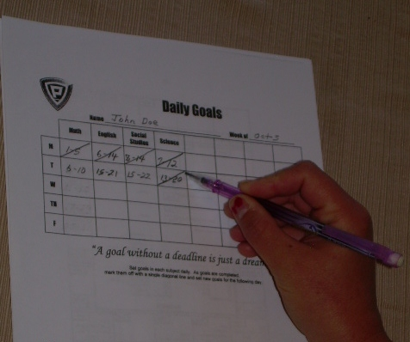
Your student will be trained in time management techniques that require setting and completing daily, weekly, and semester academic goals, which you will help determine. The Daily Goal Chart is used to help the student visualize exactly which pages/lessons of work must be completed by the end of each school day in order to earn transcript credit by the end of the semester or school year. Staff will help your child plan and complete his/her daily “quota pages” while working independently at his/her private cubicle (office).

Slide 23
Students will also be required to prepare for and pass state exams in order to earn a diploma. Your child may be required to participate in scheduled tutorial sessions in order to enhance reading and/or math skills, or to prepare for state exams. Your cooperation will be needed if your child is required to stay extra hours after normal dismissal time or even on Saturday. Such tutorial sessions are not acts of punishment. Rather, they are opportunities to avoid failure to graduate.

Slide 24
Please feel free to ask any questions which have been raised as you watched this presentation or during the enrollment process. Now is the time for you and your student to understand the policies and opportunities which define Choice High School. Our school is designed to help students earn their diplomas in a pleasant, safe, and efficient environment. If that is your desire, then let’s proceed with the enrollment process and get started!

